Slide 1

DriverPass System Analysis
Armon Wilson
Notes:
[No speaker notes required for this slide.]

Slide 2

System Requirements
Functional Requirements:
The system shall allow students to schedule, modify, and cancel driving lessons online.
The system shall provide a variety of practice tests that simulate the DMV driving test.
Non-Functional Requirements:
The system shall provide a fast and responsive user experience, with page load times not exceeding 3 seconds.
The system shall encrypt sensitive user data, such as personal information and payment details, both in transit and at rest.
Notes:
In this presentation, we've highlighted two key functional requirements that directly address DriverPass's core needs. First, the system will enable students to easily schedule, modify, and cancel driving lessons online, providing the convenience and flexibility they seek. Second, the system will offer a variety of practice tests that simulate the DMV driving test, ensuring students are well-prepared and confident on test day.
We've also emphasized two crucial non-functional requirements. The system will prioritize a fast and responsive user experience, ensuring that students and instructors can seamlessly interact with the platform without delays or frustrations. Robust security measures, including data encryption, will be implemented to safeguard sensitive user information and maintain the trust of DriverPass's clients. These non-functional requirements are essential for the system's overall success and user satisfaction.

Slide 3
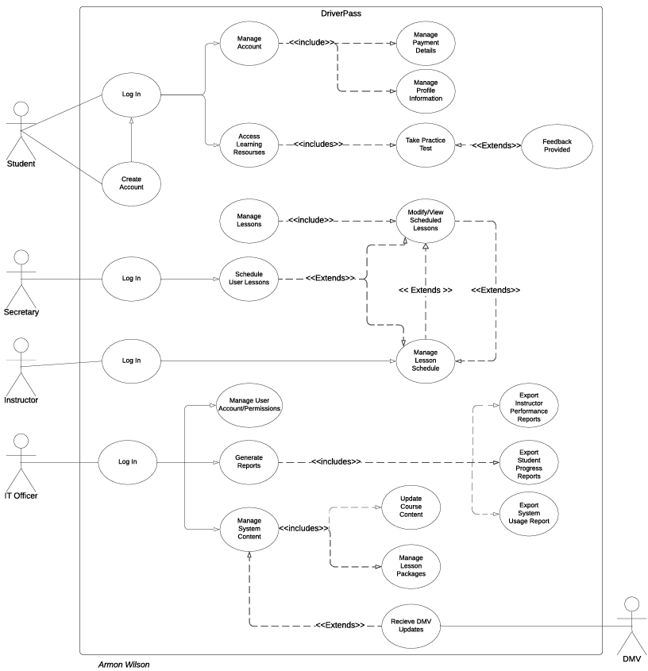
Use Case Diagram
[Insert your use case diagram here.]
Notes:
This diagram effectively illustrates the main components of the DriverPass system and how different users will interact with it.
The diagram shows three main users of the system: the student, the instructor, and the IT officer. The secretary is also shown as a user, but their interactions with the system are limited to scheduling lessons for students. The DMV is shown as an external system that interacts with the DriverPass system.
The diagram also shows the different functions that each user can perform. For example, students can create accounts, log in, update their profiles, access DriverPass content, complete learning modules, create and modify reservations, select modules, and check availability. Instructors can log in, schedule user lessons, and provide feedback. The IT officer can log in, manage user accounts and permissions, generate reports, and update DriverPass content. The DMV can update DriverPass content.
This diagram accounts for DriverPass's needs by showing how the different users will interact with the system to complete their tasks. For example, the diagram shows that students will be able to create accounts and log in to the system. They will then be able to access DriverPass content, complete learning modules, and create and modify reservations. Instructors will be able to log in to the system and view their schedules. They will also be able to provide feedback to students. The IT officer will be able to log in to the system and manage user accounts and permissions. They will also be able to generate reports and update DriverPass content. Any updates from the DMV will notify the IT officer to update DriverPass content.

Slide 4
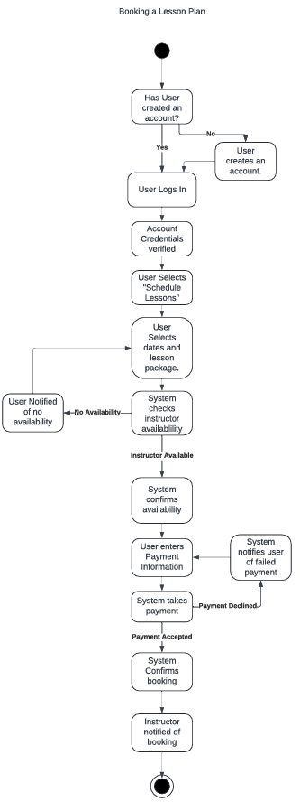
Activity Diagram
Notes:
This diagram outlines the step-by-step process a customer goes through when they want to book a driving lesson with DriverPass. Think of it like a roadmap to guide you through the process from start to finish.
First, the customer logs into the system using their existing account. If they don't have an account yet, they'll need to create one. Once logged in, they can select the option to schedule a lesson.
Then, the customer will choose the dates and the type of lesson package they want. Behind the scenes, our system checks if we have driving instructors available for those dates. If instructors are available, the system will confirm and proceed to the payment step. If not, the customer will be informed that no instructors are available and the process will stop there.
Next, the customer enters their payment information. If the payment is declined, the system will notify the customer, and they can try again. If the payment is accepted, the system will confirm the booking. It's like reserving a seat on a flight!
To make sure everyone is on the same page, the system will send a notification to both the customer and the instructor to confirm the lesson details. It's that simple!
In designing this process, we took into account DriverPass's focus on providing a convenient and efficient way for customers to book lessons. By offering online scheduling and secure payment processing, the system streamlines the booking process, making it easier for customers to access DriverPass's services. This ultimately supports DriverPass's goal of attracting more customers and providing a better driver training experience.

Slide 5
Security
Strong passwords
Secure login
Encrypted data
Role-based access
Notes:
DriverPass understands the importance of keeping customer data safe and secure. That's why we've designed the system with several security features in mind.
First, we'll require all users to create strong passwords that are difficult to guess. This will help to prevent unauthorized access to accounts.
Second, we'll use secure login procedures to verify the identity of each user. This will help to ensure that only authorized users can access the system.
Third, we'll encrypt all sensitive data, such as credit card information and personal details. This will make it much more difficult for hackers to steal this information.
Finally, we'll implement role-based access controls. This means that different users will have different levels of access to the system, depending on their role. For example, administrators will have more access than students. This will help to prevent unauthorized users from making changes to the system or accessing sensitive data.

Slide 6
System Limitations
Limited offline access
Dependence on DMV updates
Potential scalability challenges
Integration complexities
Notes:
While we've designed a robust and comprehensive system for DriverPass, it's important to acknowledge a few potential limitations.
While the system primarily functions online, there might be limited offline access to certain features or content. This could be a consideration for students with unreliable internet connections.
The system relies on the DMV for updates on driving rules and regulations. Any delays in receiving these updates could temporarily affect the accuracy of the information provided.
As DriverPass grows and the number of users increases, we might encounter some challenges in scaling the system to meet the increased demand. However, we've designed the system with scalability in mind, and we'll be monitoring its performance closely to address any potential issues.
Integrating the system with external platforms, such as the DMV database or payment gateways, could present some complexities. We'll work closely with these external partners to ensure smooth integration and minimize any disruptions.

